Slide 1
IST769 Unit B
The Foundations of NoSQL

Slide 2
Agenda
Why Data is important?
Criticisms of Relational
Scalability / Distributed Databases
ACID vs BASE
Non-Relational Models
Polyglot Persistence

Slide 3

The Importance of Data

Slide 4
Questions?
Why are Facebook, Google, and Twitter free services?
Why do companies like Target, Starbucks, and Verizon have customer rewards programs?
What makes rideshare services like Uber or Lyft more efficient than taxis?
DATA
Notes:
In the case of Facebook, Google and twitter, we offer personal information about ourselves including what we are doing in our lives in exchange for use of their services. In turn these companies use this data to better market to us. This is similar with rewards programs from companies like Target, Starbucks and Verison, only they use our spending habits to market product and services. Data about customers using the ride share services is what makes them more efficient that taxi companies.

Slide 5
Two Kinds of Data
Reference-Oriented Data
Process-Oriented Data
Business Entities; Data that references a person, place or thing
Any row is updatable over time, Full CRUD
Limited growth, can be frequent changes.
Rows referenced by a natural or business key
Data Relationships; Data corresponding to an event or process
Immutable – rows do not update, CR no UD
Rapid growth
Rows have no natural key; have a timestamp or composite key

Slide 6
Which kinds of data are these?
REFERENCE or PROCESS oriented data?
Student information like name, email, address, gpa
A Student Enrolling in a course, like this one.
A sensor that records temperature every 10 seconds
A room in a building (where that sensor might be placed)
Web analytics (clickstream)
The books found in a library
Notes:
REF
PROC
PROC
REF
PROC
REF

Slide 7
The Prevalence of Data
Data are everywhere!
There has been an explosion of data over the past few years
The majority is process-oriented data.
There are new varieties of data.
Business data → user generated data → device generated data
And there are different mediums than before.
Structured → semi-structured → unstructured text → multimedia

Slide 8
How the volume of Organizational data has grown over time.
Business Data
Web/Clickstream
Social Networks
Mobile
Sensor/IoT
Data Volume
1980
1990
1995
2000
2005
2010
2015
2020
Years

Slide 9
The majority of data originated today comes from:
Business processes, like sales of products.
People, through page clicks and posts to social media sites like Facebook and YouTube
Network-connected Devices; the Internet of Things
Notes:
3

Slide 10
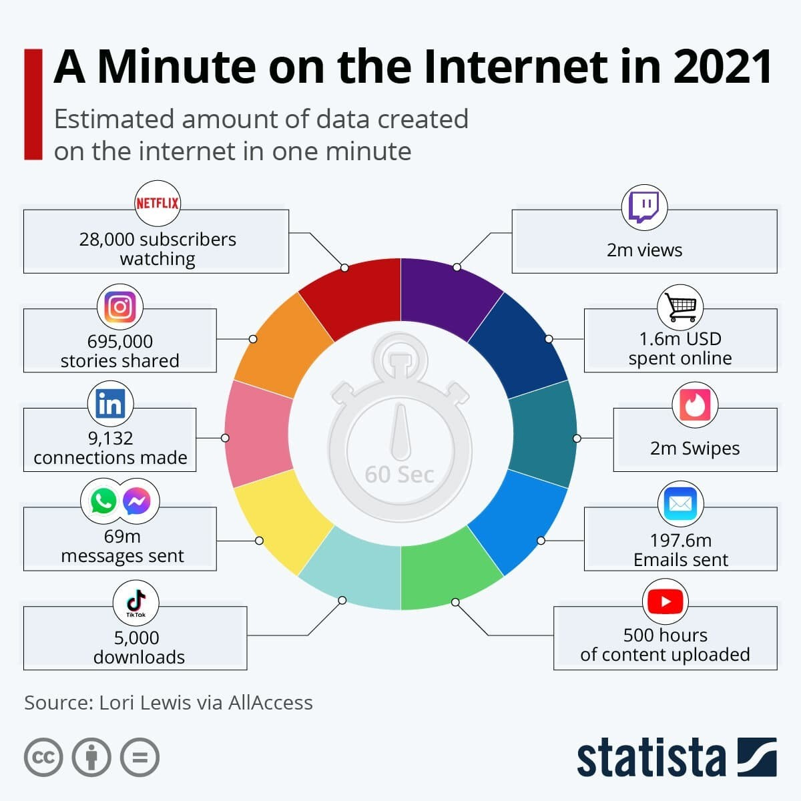

Slide 11












How many devices are connected to the Internet?
2020 50B
Billions of Devices
2019 42.1B
50
2017 28.4B
2016 22.9B
2018 34.8B
40
2014 14.2B
2015 18.2B
30
2009 IoT Inception
20
2012 8.7B
1992 1M
2003 0.5B
10
2013 11.2B
0
1988
1992
1996
2000
2004
2008
2012
2016
2020
Notes:
The number of devices connected to the internet has already surpassed the global population. This trend will continue until there are an estimated 50 Billion devices… or approximately 6 devices per every single person on the planet!

Slide 12
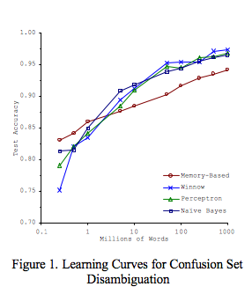
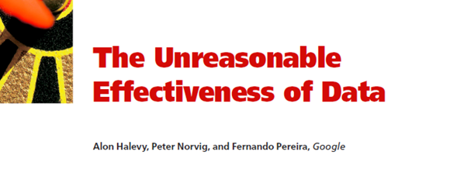
More Data… Better Machine Learning!
Halevy, Norvig & Pereira, 2009: “Data set size matters
more than algorithms”
This is why Big Data is important. Size does matter!
Data matters more than the algorithm!
Banko & Brill, 2001: “Algorithms Predict Better with Larger Data Sets”

Slide 13
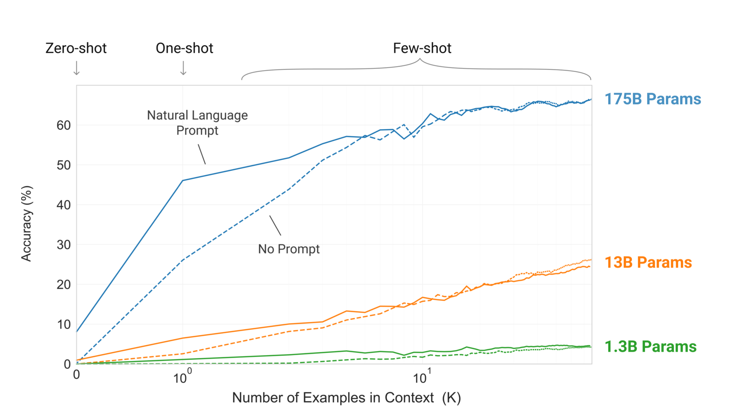
GPT-3 – A Text Completion Model
Notes:
Zero shot, one shot, few shot is the amount of training to the task, like completing an email for you or predicting a sequence of steps.
1.3B is GPT
13 B is GPT2
175 B is GPT3
https://medium.com/analytics-vidhya/openai-gpt-3-language-models-are-few-shot-learners-82531b3d3122

Slide 14
The extraction of value from data is not trivial
The more data, the greater the chance for value within
But the data the more effort is required to extract that value!

Slide 15
So, What Exactly is “Big Data?”
It’s a buzzword for what we know already.
More data == more insights.
Machine learning models perform better with more data.
But there is an analysis gap because there’s too much data to sift through.
We need to scale this problem out, storing and processing the data over several distributed computers.
Not all this data is CRUD / OLTP, so it doesn’t necessitate use of an RDBMS.

Slide 16
Check Yourself!
According to the author of this article, extracting value from big data is difficult. Why do you think this is so?
https://www.cioinsight.com/it-management/expert-voices/why-extracting-value-from-big-data-is-difficult.html
Notes:
3

Slide 17

Criticisms of the Relational Database Model

Slide 18
What Makes the RDBMS Great?
Easy to understand tabular structure,
Table meta-data and data integrity constraints help to ensure we don’t write “bad data”
Data in tables are normalized to minimize redundancy and improve data consistency
Wide adoption and an abundance of tools
Support for SQL (Structured Query Language), which is easy to learn
ACID: Writes are atomic, consistent, isolated, and durable.
The de-facto standard—mature and proven

Slide 19

When all you have is a hammer (RDBMS), every data problem looks like a nail.

Slide 20
One Size Does Not Fit All !
No one database management system is best suited for all of the complexity and variety of data found today.
Therefore, different systems exist; to manage data that vary in:
Structure
Size
Rate of change
We’ve learned the hard way that not all data problems are nails, and there is more than just the hammer.
Most relational database vendors are keen to this and now offer hybrid options, that go beyond relational, but still….

Slide 21
Three Main Criticisms of the RDBMS
Rigid schema does not support storage of variety of data for purposes beyond OLTP.
Systems do not scale. Consistency of RDBMS makes them difficult to distribute
Data is stored at rest; RDBMS does not handle data in motion.

Slide 22
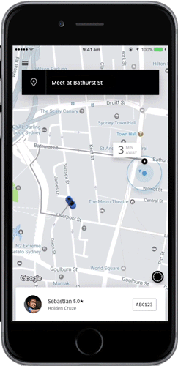
Hammer-Nail Example
How do your build this presentation layer with an RDBMS?
What data would be stored?
How might you update this screen?
Would your design work at scale, say thousands of riders each minute?

Slide 23

Scalability

Slide 24
RDBMS does not scale easily
Out of the box, Increases in data volumes and transactions per second lead to decreases in performance.
Companies throw hardware at the problem, buying datacenter in a box solutions like Oracle RAC, SQL Server MPP, or Vertica. This is expensive!
Companies hire specialists to set up clustering and improve performance through indexing, caching, and partitions. Requires money and expertise!
NewSQL: “We can scale that for you, but you will need to use the cloud!” - Google Cloud Spanner, Amazon Aurora, or MemSQL.

Slide 25



Scaling: Up Versus Out
Vertical Scaling “Up”
Horizontal Scaling “Out”
Add more resources to an existing system running the service
Easier, but limited scale
Single point of failure
Any system can be scaled up
Run the service over multiple systems, and orchestrate communication between them
Harder, but can achieve unlimited scale
Overhead resources needed to manage nodes
System must be designed to do it
Notes:
Amazon EC2

Slide 26
Over-Simplified Example: A Website Hosted at AWS
Scale it up
Scale it out
It is hosted on amazon EC2.
Upgrade the compute instance from
t2.micro 1 CPU 1 GB to
t2.xlarge 8CPU 32 GB
Just pay more and you are done.
When you update the website content, you do it once.
Setup AWS Elastic Load balancer in front of your site.
Duplicate your t2.micro instance 7 times (you now have 8 copies)
Configure ELB to route traffic to one of your 1 of 8 instances of your website.
When you update the website, you need do it 8 times

Slide 27
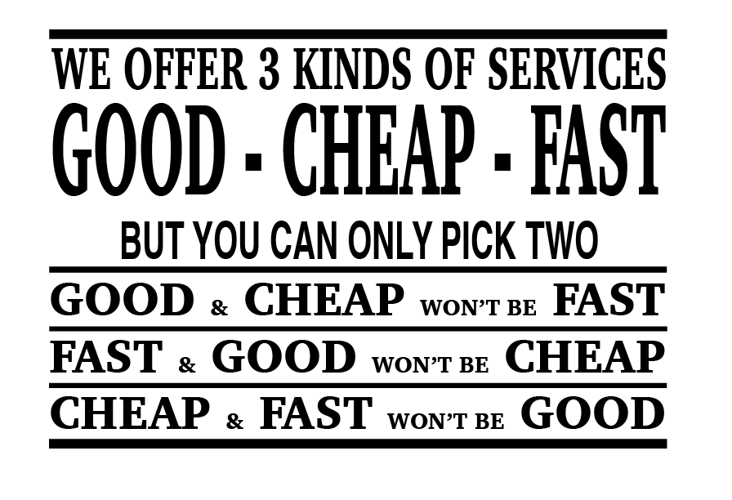

Slide 28
The CAP Theorem of Distributed Data Stores
Eric Brewer: You can only have two of the following three guarantees:
Data consistency: all nodes see the same data at the same time
Data availability: assurances that every request can be processed
Partition tolerance: network failures are tolerated, the system continues to operate
Relational DBMS are designed to be consistent and available and therefore cannot be partition tolerant.

Slide 29
Why Can’t We Have All 3?
Node 1
Node 2
Suppose we lose partition tolerance between nodes. Then:
We must ignore any updates the nodes receive, or we sacrifice consistency,
Or we must deny changes until it becomes available again.
If we guarantee availability of requests, despite the failure:
We gain partition tolerance (the system still works) but lose consistency (nodes will get out of sync).
If we guarantee consistency of data, despite the failure:
We gain partition tolerance (again, system works) but lose availability (data on nodes cannot be changed, until the failure is resolved).

Slide 30
Match each term to its definition
Adding additional resources to an existing system
A system continuing to operate despite a network failure
Assurances that data read and write can be processed
The ability for all data nodes to see the same data concurrently
Distributing a system over several network-attached computers
A. Scale out
B. Data availability
C. Data consistency
D. Scale up
E. Partition tolerance

Slide 31
Database Systems and the CAP
Consistency
Partition
tolerance
Availability
Non-Distributed
Single-master
What is guaranteed?
CA
CP
X
AP
Eventual consistency

Slide 32
Single Master CP Systems
A leader node is responsible for orchestration of writes.
Leader goes down we lose availability as we can no longer write.
leader
A,B
A,C
C,B

Slide 33
Eventual Consistency AP Systems
B,C
There is no leader node.
Any node can fail and we can write still but our reads will be inconsistent.
A,B
C,A
Notes:
You are

Slide 34
All Types of CAP Databases
CA: RDBMSs like Oracle, MySQL, and SQL Server:
Focus on consistency and availability (ACID principles), sacrificing partition tolerance (and thus they don’t scale well horizontally)
Use cases: business data, when you don’t need to scale out
CP: Single-master systems like MongoDB, HBase, Redis, and HDFS:
Provide consistency at scale, but data availability runs through a single node
Use cases: read-heavy; caching, document storage, product catalogs
AP: Eventual consistency systems like CouchDB, Cassandra, and Dynamo:
Provide availability at scale but do not guarantee consistency
Use cases: write heavy, isolated activities: shopping carts, orders, social media

Slide 35
ACID vs BASE
ACID Databases (CP)
BASE Databases (AP)
Atomic: Everything in a transaction succeeds, or the entire transaction is rolled back.
Consistent: A transaction cannot leave the database in an inconsistent state.
Isolated: Transactions cannot interfere with each other.
Durable: Completed transactions persist, even when servers restart and so on.
Basic availability: Data can be read and written to any node.
Soft-state: Nodes may change over time, even without direct updates.
Eventual consistency: At some point all nodes will have the same data.

Slide 36
So, all Distributed Databases Are a Choice Between Availability and Consistency?
Well….

Slide 37
NewSQL Systems
Service
Discovery
Leader 1
Leader 3
Circumvent the CAP theorem by combining AP and CP systems
Leaders are AP and always available,
Data storage is CP and thus always consistent.
Leader 2
A,B
A,C
C,B
Database
Notes:
You are

Slide 38
NewSQL
The Relational Model at Scale;
ACID Compliant
Horizontal Scalability
Complex system architecture thus cloud hosted or Kubernetes.
Database as a service in the cloud:
Google cloud spanner, Amazon Aurora, Azure CosmosDb, MemSQL
Open source:
CockroachDB, YugabyteDB

Slide 39
Check Yourself
Produce appropriate use cases for both CP and AP systems.

Slide 40

NoSQL
The Rise of NoSQL

Slide 41
Why Stop At Scalability?
Let’s question everything about relational databases.
Metadata schemas are too rigid for non OLTP activities.
I don’t need my data normalized. Storage is cheap.
Integrity constraints and triggers at the data layer hinder performance.
There is no need for ad-hoc queries or SQL. I know what I want out of the database.
Security? It can be handed in the application layer.
Relations do not suit my data well. I need object storage, better search, or complex data relationships

Slide 42
NoSQL
NoSQL == “not only SQL.”
It generally refers to a wide range of database systems that address the scalability and other challenges of the relational database model.
The entire point of NoSQL is that your need is not met by the relational model (really has nothing to do with SQL itself).
It is not an anti-SQL or anti-relational database movement, although it is perceived that way.
Not all problems are nails. Not all solutions are hammers!

Slide 43

Data Models
Of NoSQL Databases

Slide 44
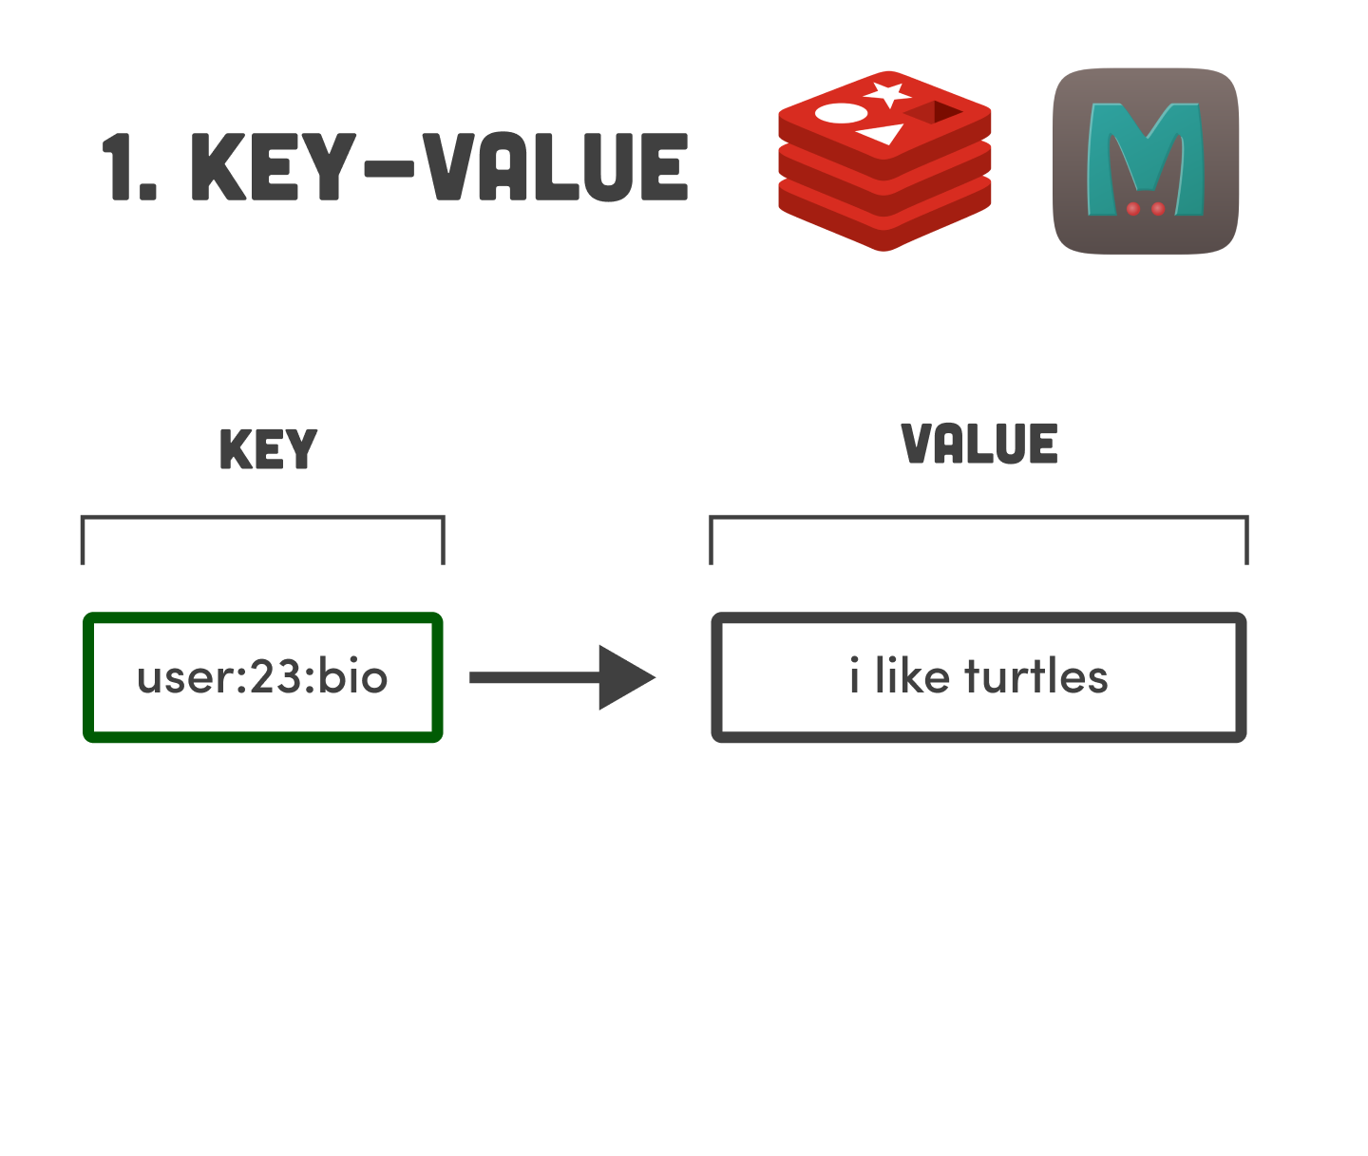
Key-Value
Data stored under a key.
Value can be anything.
Keys can be name spaced.
Very simple data model.
Very fast and efficient.
Supports full CRUD.
Commonly used to store data you need to retrieve quickly, as if it were in memory.
Simple Query Language

Slide 45
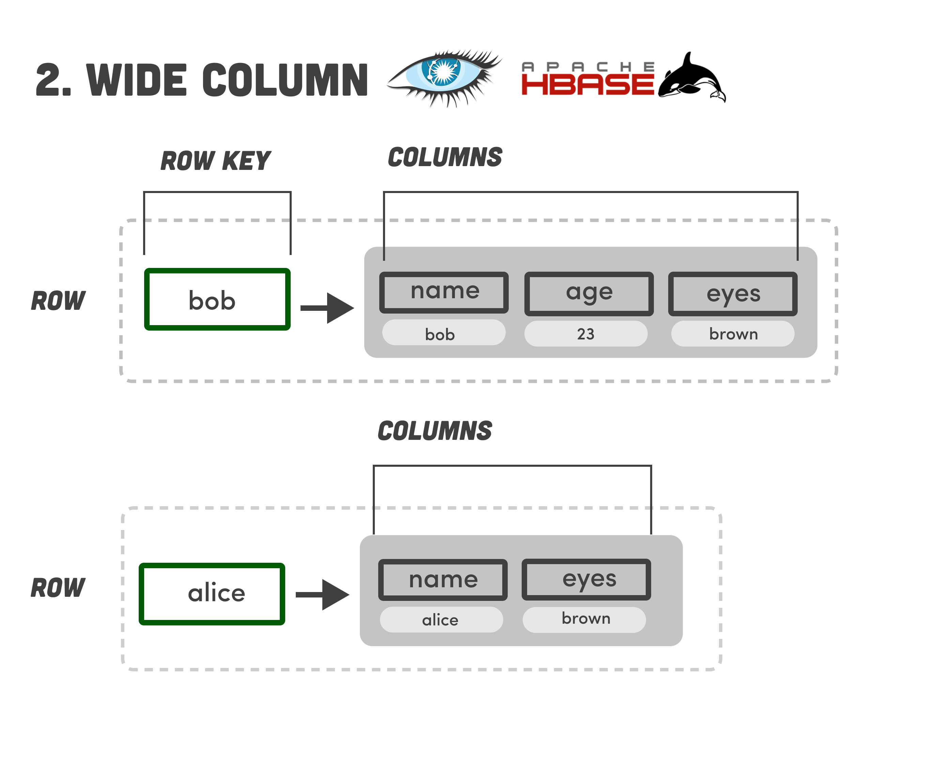
Wide-Column
Data stored under a row key.
Value consists of columns of data in one big table.
Every row does not need the same set of columns. Flexible schema.
Common columns can be grouped and stored together.
Not full CRUD, more CR.
Designed to be BASE; Fast, guaranteed writes.
SQL-Like query language

Slide 46
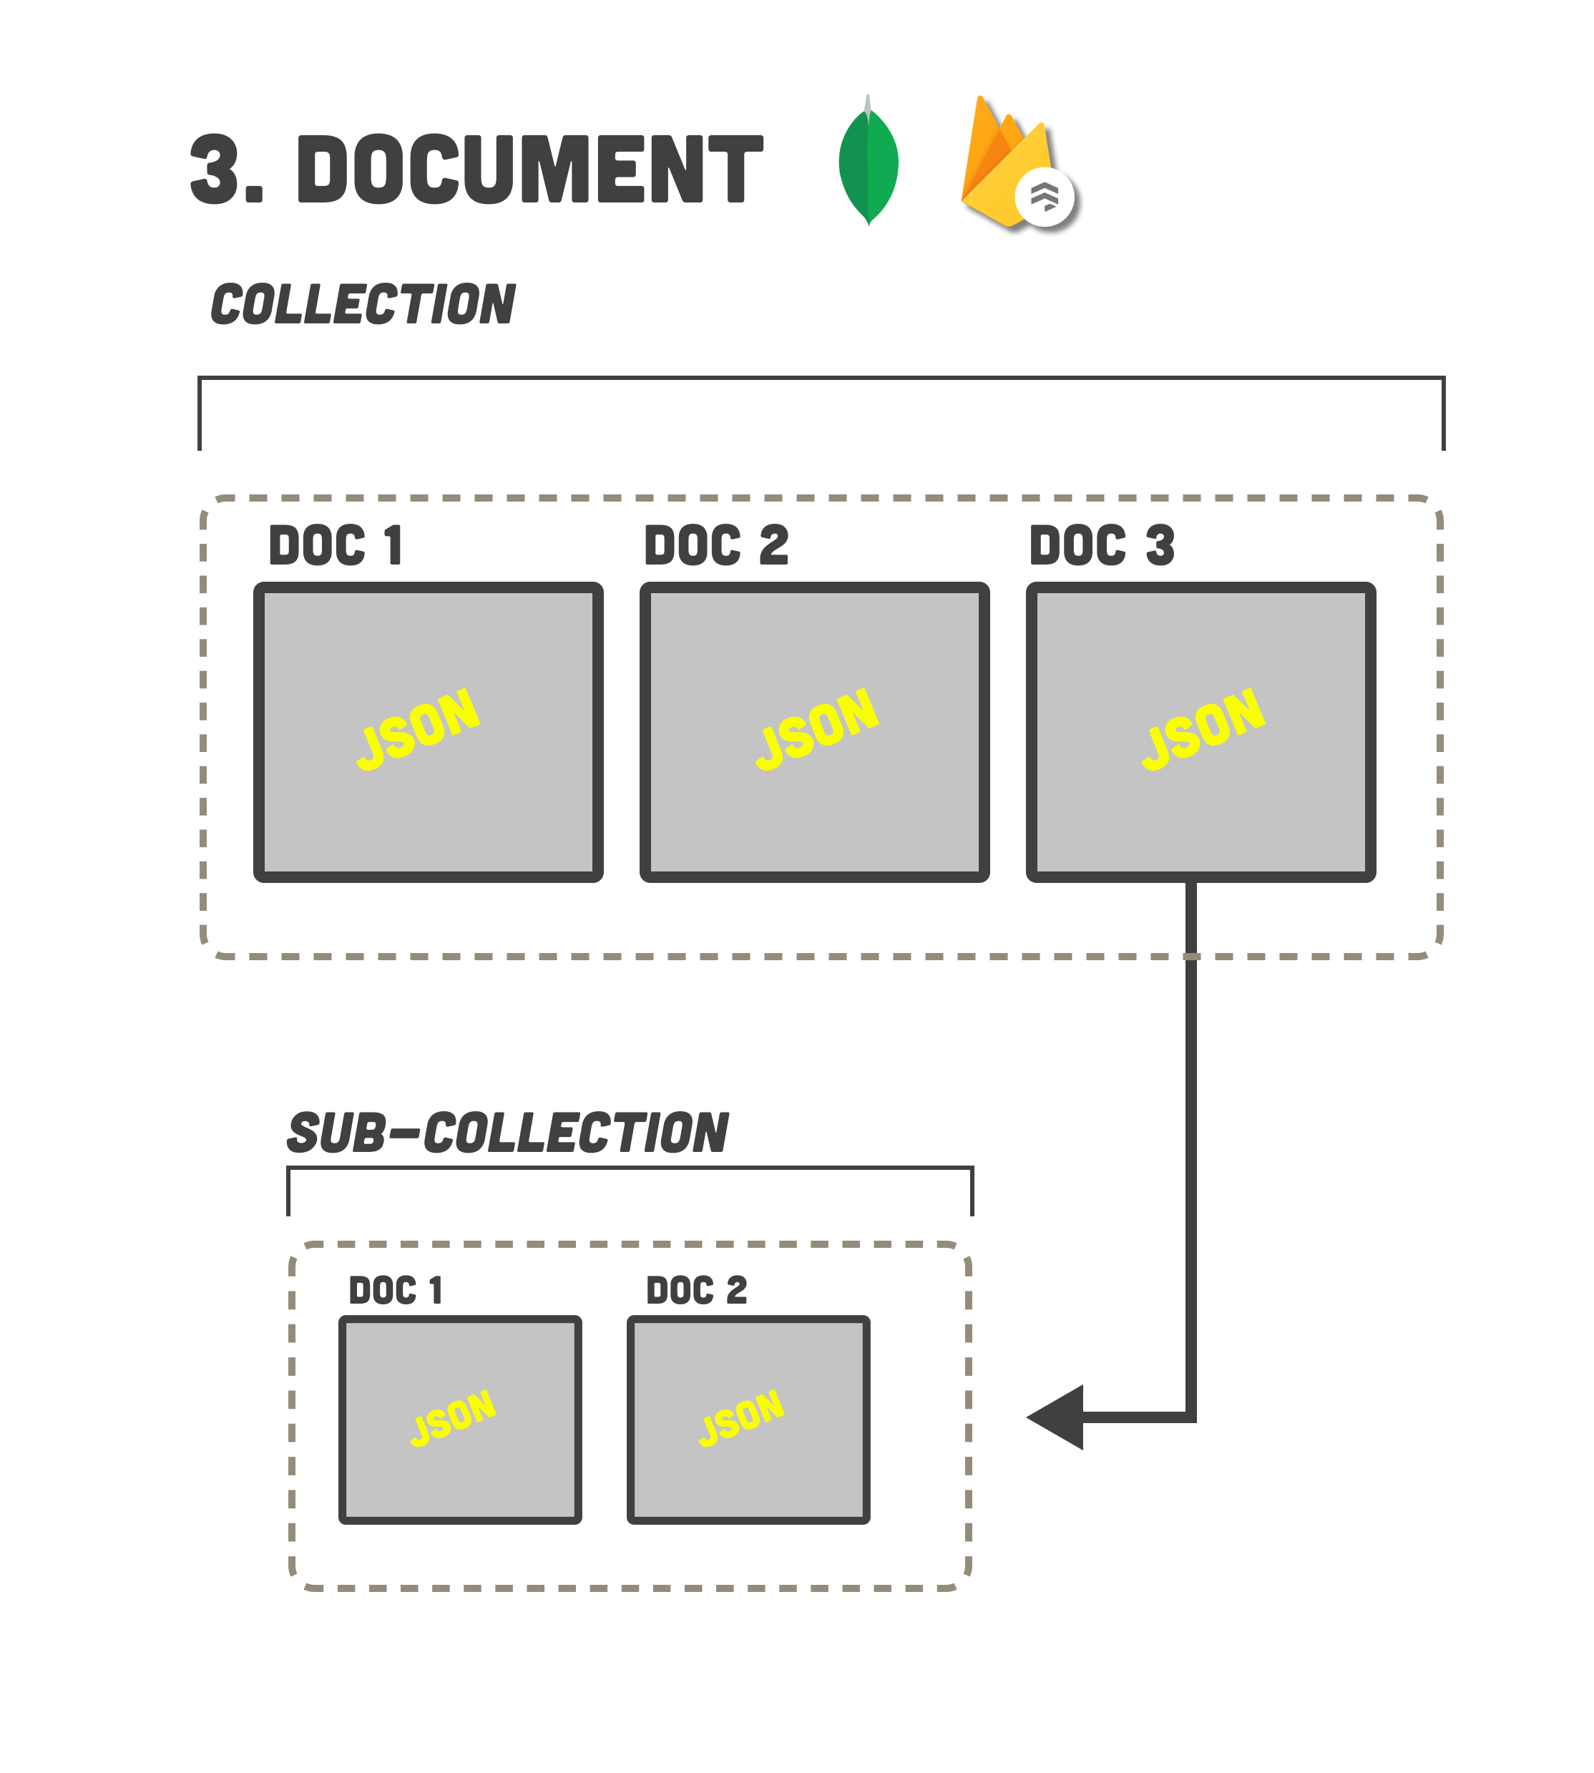
Document
Keyed Data stored as documents in collections.
Data is usually semi-structured, JSON format, consisting of key-value pairs.
Documents in collections can have pointers to documents in other collections.
Full CRUD.
Systems can be ACID or BASE
Custom Query Language

Slide 47
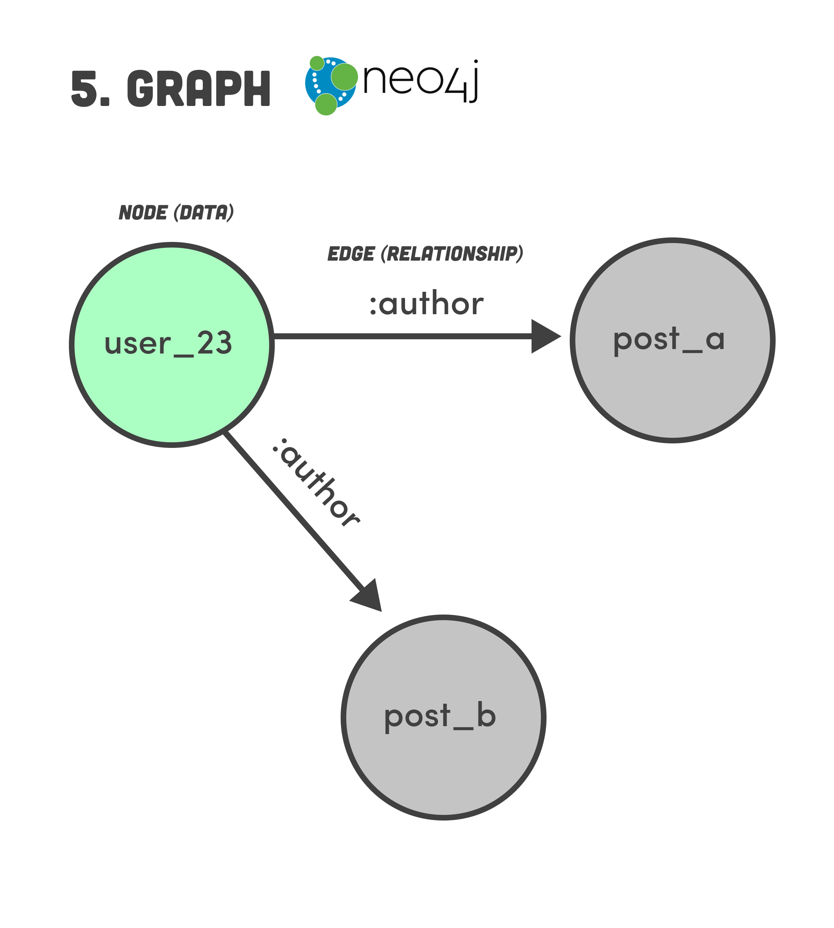
Graph
Data model consists of node and edges.
Structured and unstructured data may be stored in both the node and edge.
Idea for data consisting of complex relationships.
Supports full CRUD.
Systems can be ACID or BASE
Custom Query Language, very unlike SQL.

Slide 48
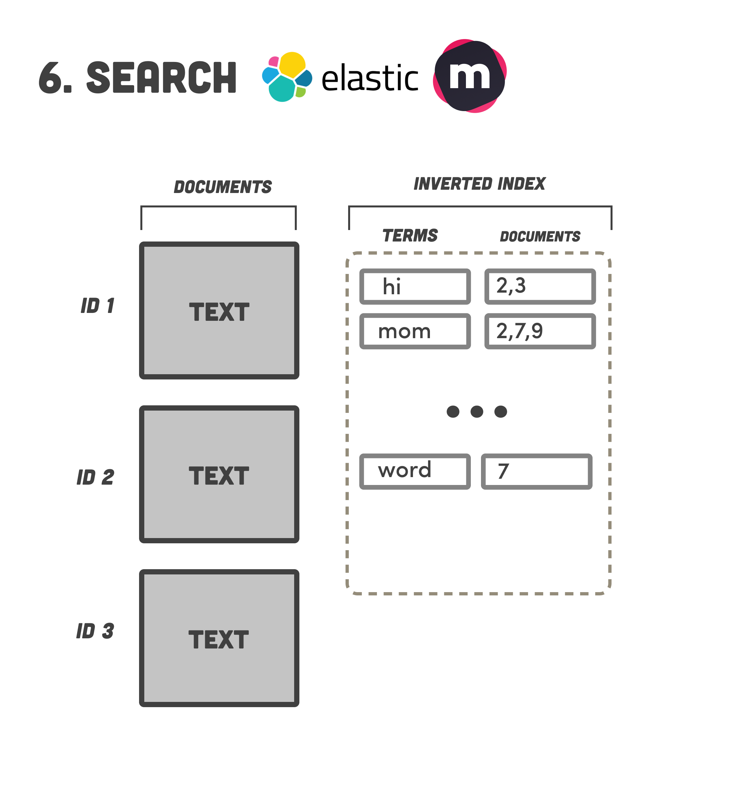
Search Engine
Documents can be structured, semi-structured, or unstructured.
Indexes are created over the documents, and one can search for any content within the document.
Search can find any data within the document; semi-structured data can be keyed.
Not full CRUD, more CR.
Systems are typically BASE
Custom Query Language, non-SQL like.

Slide 49

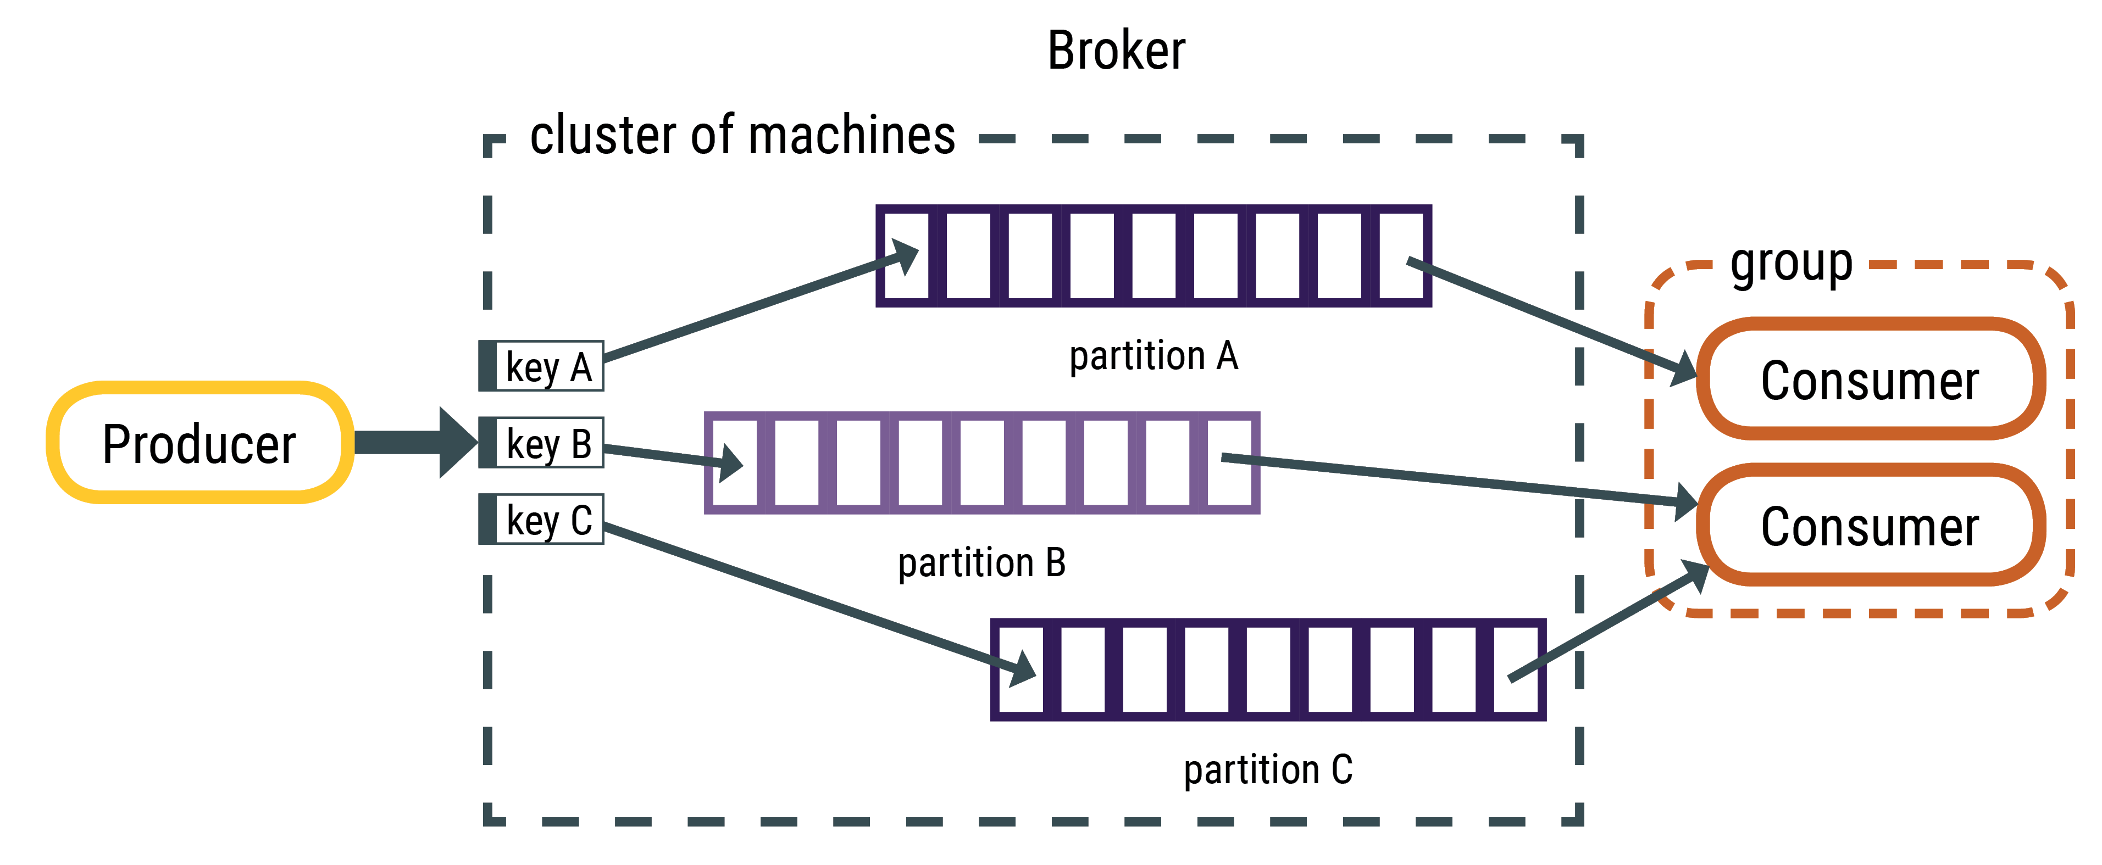
Streaming
Supports structured, semi-structured, or unstructured data.
Data in motion, not data at rest.
Producers sends data, consumers receive it.
Data is sent to a topic where it awaits consumption by consumers.
Systems are typically BASE + ACID
API’s for publishing / subscribing to topics.
Custom Query Language

Slide 50
Multi Model
Microsoft SQL server is a relational database but has adopted many of the features found in NoSQL databases.
In memory tables for basic CRUD operations (Like Key-Value)
Document database for no-schema
Graph support databases
Temporal tables for tracking changes to data over time
Connectors to query unstructured data.
Most RDBMS are now Multi-Model, including support for other models like Graph, Document, and Key-Value.
This does not imply these systems will scale horizontally easily.

Slide 51
Match the Database Model
Key-Value
Relational
Streaming
Search
Graph
Document
Wide Column
Collections of JSON
Nodes and Edges
Simple CRUD
One large table
Tables and Foreign Keys
Data in motion
Indexes all data
Notes:
1. C
2. E
3. F
4. G
5. B
6. A
7. D

Slide 52

Modern Data Architectures
And Polyglot Persistence

Slide 53
Polyglot Persistence
Long gone are the days of ERPs with organizations using just one DBMS.
Scalable web and mobile applications, data warehouses, real-time analytics require a different way of thinking.
Embrace the diversity of database models and leverage their advantages.
What about reporting and analytics? Build a data warehouse, of course!

Slide 54
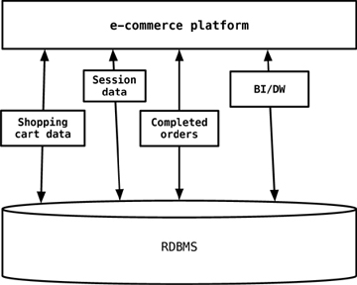
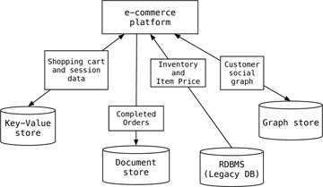
Stop using the same hammer!
https://www.informit.com/articles/article.aspx?p=1930511&seqNum=2

Slide 55
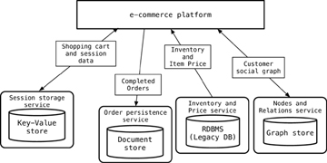
Service Orientation
No direct access to a database!
Instead, we build web services to access the data we need from the database.
While this increases the system complexity, it decouples the system dependency on any database, making it easier to switch to another database later…

Slide 56
Example: Same API, Two Different Implementations
E-commerce platform
Shopping Cart REST API Service (Python, Java, etc…)
HTTP GET /getcart/{userid}
HTTP POST /addtocart/{userid}/p={prodid}
A
B
RDBMS Implementation
SELECT * FROM cart WHERE userid={userid}
INSERT INTO cart VALUES ({userid, {prodid})
Redis Key/Value Implementation
LGET {userid}
LPUSH {userid} {prodid}
A
A
B
B

Slide 57
Polyglot Pros and Cons
Pros
Cons
Better performance and scalability.
It is cloud friendly and easy to switch out components.
Use the best tool for the task.
No interoperability: You must connect the databases together.
You must decide where data should be stored.
There is increased complexity and administrative burden.

Slide 58
Match the Terms
Polyglot persistence
Service Orientation
Access to a database through an API.
Use of multiple database systems within an application
Notes:
1 = b
2 = a

Slide 59
Summary
Data is an asset; the more data the more value; extracting value is hard
Relational is not well suited to large volumes of data or unstructured data.
The CAP theorem explains the limitations of distributed database systems.
NoSQL databases address horizontal scalability and different database models
Polyglot Persistence embraces data complexity by using the right database for the task at hand.
Service-orientation decouples the applications API from the database API.

Slide 60
Exit Ticket
What was the most difficult concept from this week’s lesson?

